Slide 1
You will create a Frame and a Timeline GIF in PS
Both GIFS should have looping endless motion. The end leads seamlessly back to the beginning. There is no clear stopping at the end.
For Frame animation, choose either flipbook or cinemagif
For Timeline choose a more complex subject where changes to color, fade ins or outs, and complex animation of several subjects, etc. are demonstrated.
There are a bunch of examples on my site and on my facebook group http://www.shanks-creative-education.com/motion-graphics-for-web.html https://www.facebook.com/groups/profshanks/
Search the facebook page using the magnifying glass, use keywords motion and gif

Slide 2
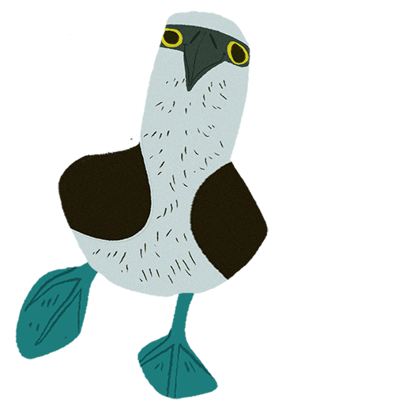
Frame Animation Types
Choose to create a flipbook (if you like the draw) OR cinemagif (if you like photography)

Slide 3
FLIPBOOK
Watch movie here: https://vimeo.com/23673802
Example of a computer graphic printed flipbook, great presentation. But notice how the end just stops and does not lead back to the beginning, this is not the type of ending you want.
Also check out this one http://escamilla000.tumblr.com/post/115025849378
Again it could have had a better end so it would loop to the beginning. But the hand drawn animation is great!
Notes:
Or play from file in folder

Slide 4
Example of a computer graphic printed flipbook, great presentation. Again great idea but the end should lead back to the beginning

Slide 5
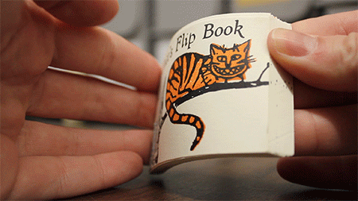
Example of a hand drawn flipbook. The end could have lead back to the beginning better by reversing the disappearing act of the cat.

Slide 6
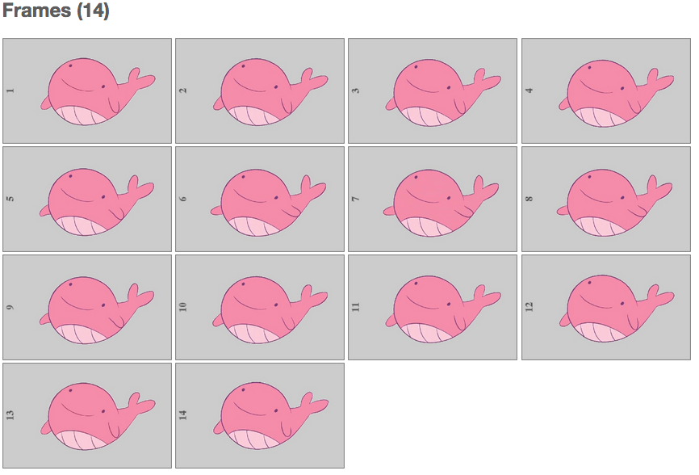
Look the motion is seamless!!! This is what we are going for.

Slide 7
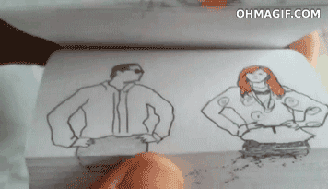
Example of a hand drawn flipbook, NOTICE how the end leads back to the beginning?? This is what you want.

Slide 8
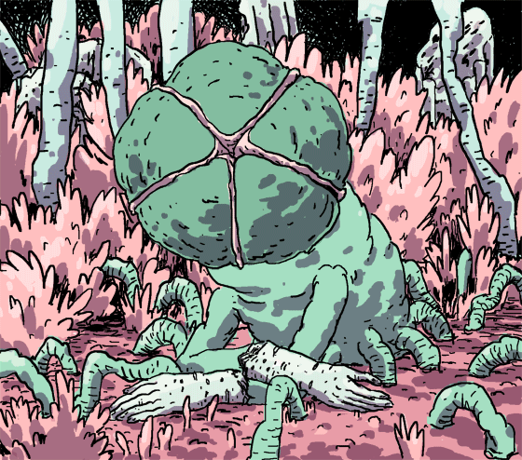
Your finished GIF will resemble something like this……endless motion
http://katedrawsthings.tumblr.com/

Slide 9
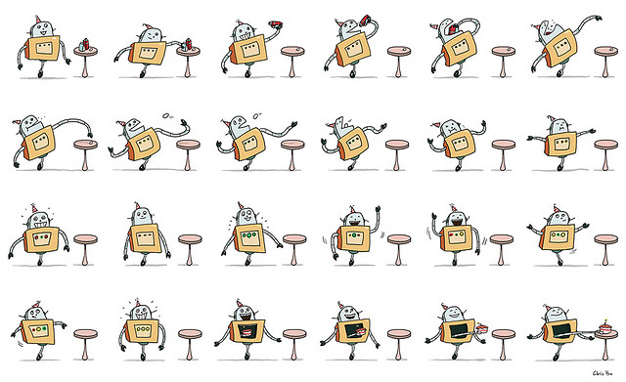
Frames from a flipbook, you will scan or load each individual frame and compile them as layers in PS to create a GIF. All you need to do for homework is create the frames either hand drawn or in PS or Illustrator. Next class we will make the animations together.

Slide 10
CINEMAGIF or CINEMAGRAPH
http://cinemagraphs.com/
So many wonderful examples here, use the navigation at the top of the page
The idea is you put your camera on a tripod. You shoot your first frame, if possible
an empty background

Slide 11
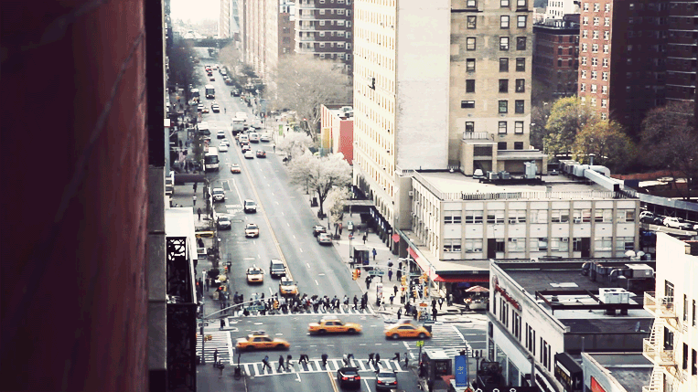
Notice how the motion is isolated and repeating. It is an endless loop and draws attention to the focal point. Nothing else moves but a single, isolated, subject

Slide 12
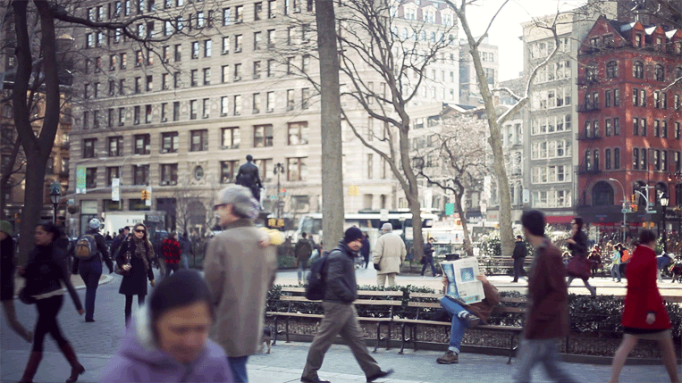

Slide 14
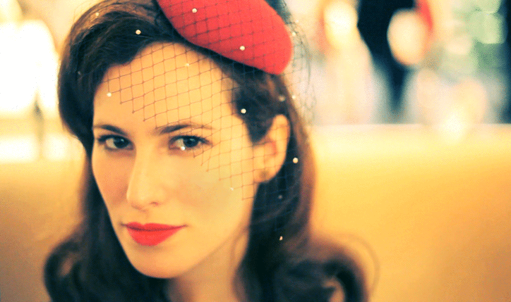

Slide 15
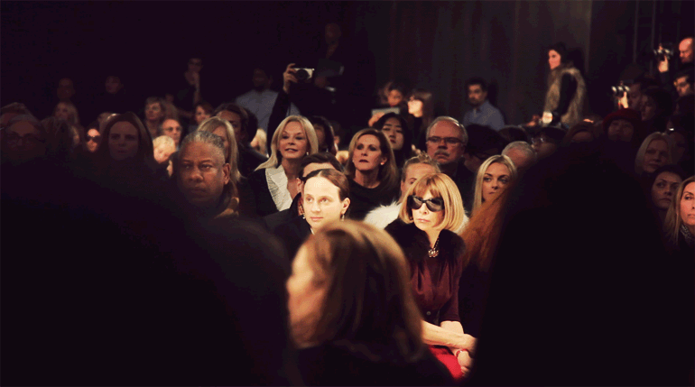

Slide 18
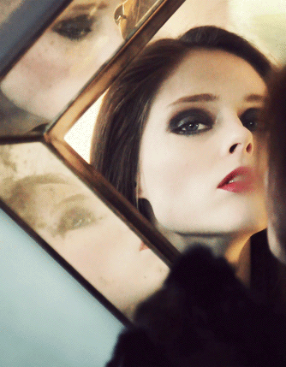

Slide 19
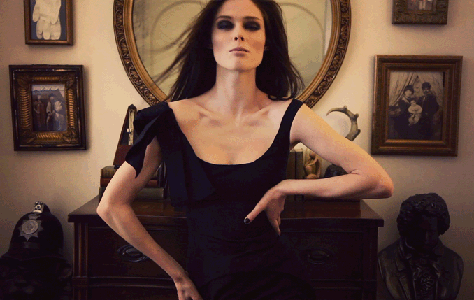

Slide 21
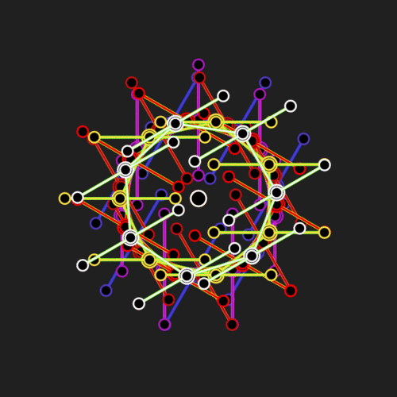
TIMELINE Animation
So many great examples on my site: http://www.shanks-creative-education.com/motion-graphics-for-web.html
Remember this is more complex. There should be effects like color change, see example below. Or it should be a more complex story like this.. https://vimeo.com/31636206 WATCH THIS, YOU WILL LOVE IT!!

Slide 22
Consider animating a logo you have made
Consider putting a logo you have made into a scene that is animated and works
with the brand you developed for the company.
Consider animating a cool graphic you have, or hand drawn type.
If you use preexisting imagery remember each thing you want to move needs to be on its own layer!
Example below from: http://dandenney.com/posts/front-end-dev/photoshops-timeline-rocks

Slide 23
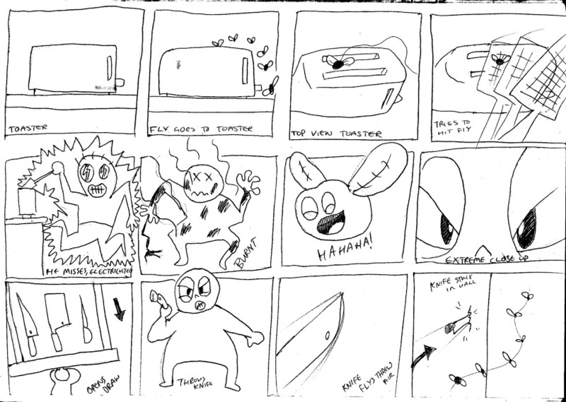
Start with storyboard! Do not come in and try to explain it to me. SHOW ME! Remember, unlike this example, think about how the end will lead back to the beginning, even if it is a simple fade back to the beginning from a similar frame at the end.

Slide 24
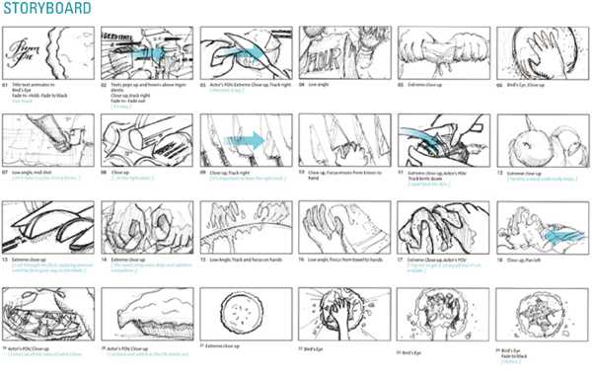

Slide 25
BE CREATIVE
CHECK OUT http://www.motionserved.com/ to get inspired, understand there are limitations in PS.
Finished Frame and Timeline GIFS (2 total) are due week 4. They should be
finished pieces you spent time developing in craft and concept.
I can not show you every technique! So some research into specialty things, specific to your project, is required! For example it will be up to you to find tutorials about drawing a character walk cycle, or making something grow, or other techniques that I am not reviewing in class. I am showing you the basics of the tools and it is up to you to bring the creativity, the will to make your project happen and the passion to make your project happen. I am here to guide and help. This class will require you to work. You may use some imagery or type projects you might already have.
Think of these are excellent portfolio pieces. Many students have gotten great jobs from their work I this class. Knowing some motion graphics and After Effects is very marketable.
This class requires you think in a different way. You have to think about how things move.

Slide 26
DUE WEEK 2
Flipbook: Drawn pages OR Cinemagif: Shoot frames (video or burst shoot photography)
Timeline storyboard. If using existing graphics or type bring them LIVE Q&A session today from 4-7. Chat me from Facebook or from Gmail cshanks.aiph@gmail.com. Review ideas with me, throw some stuff by me, or just stop in. NOT BEING ABLE TO SPEAK IS KILLING ME SLOOOOOWLY. Come converse with me…PPPPLLLLLLEEEEEAAAAAASSSSSEEEE. Typing is better than nothing.

